Slide 1
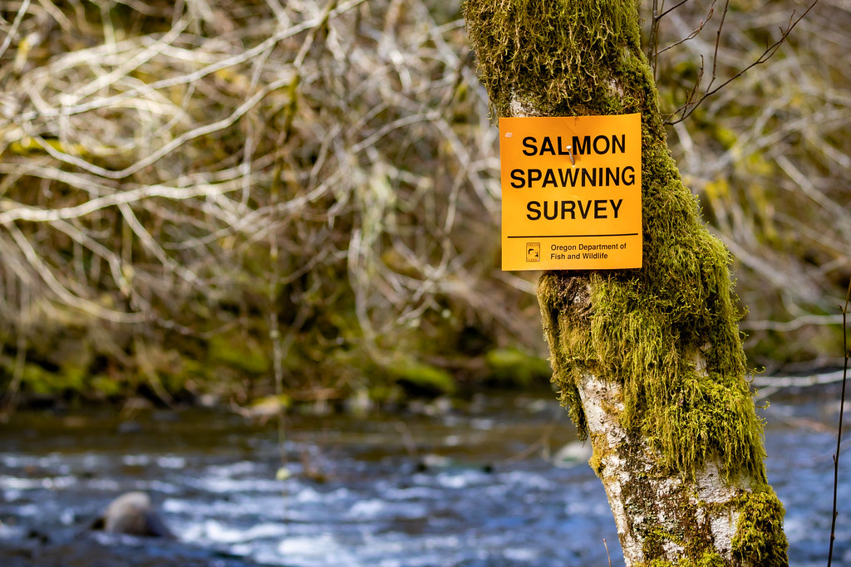
Understanding precision and directional bias of fisheries abundance estimates across 31 commonly used salmonid survey methods

Slide 2
Background

Slide 3
What are salmon?

Slide 4
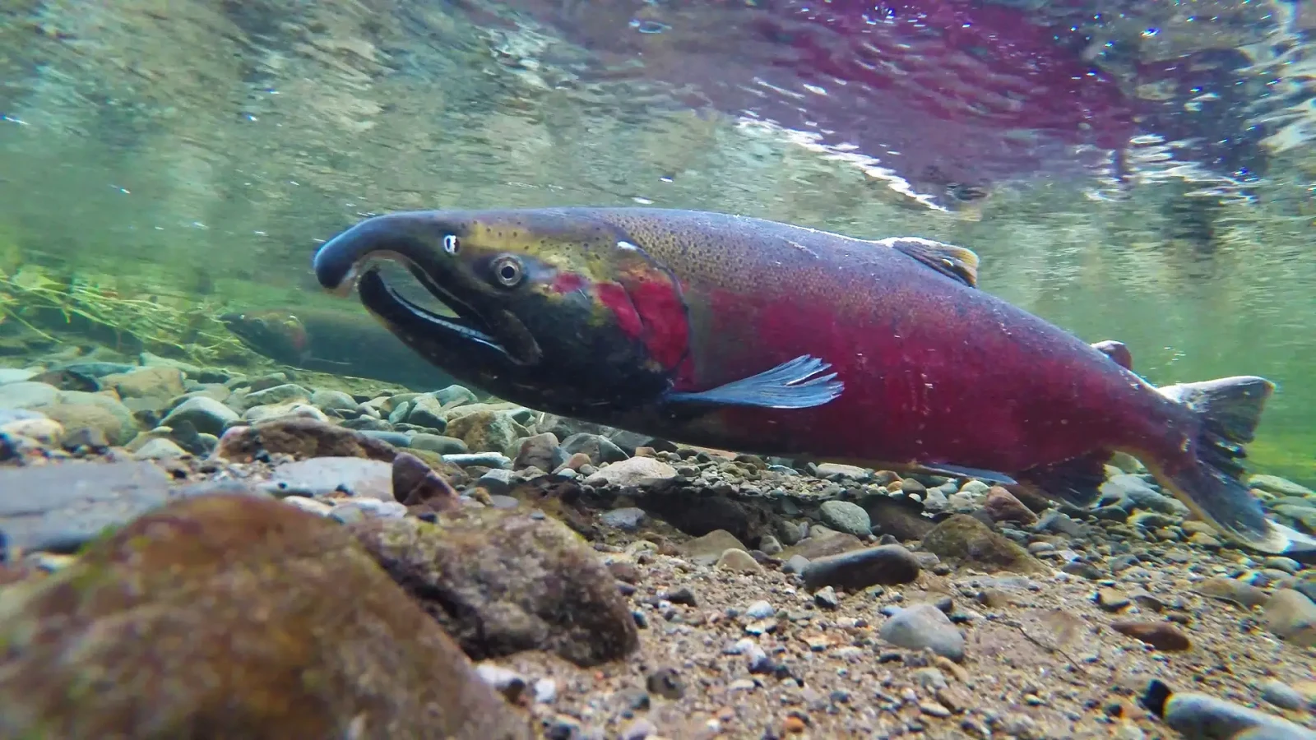
What are salmon?
Photo credit: Animalia

Slide 5
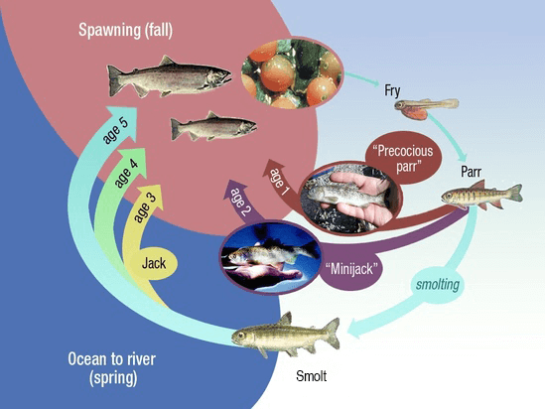
What are salmon?
Photo credit: NOAA Fisheries

Slide 6
Why salmon are important?

Slide 7
Why salmon are important?
Ecologically crucial
Notes:
Ecologically crucial species
Marine nutrients found in trees in central Idaho
Cultural significance
Central to Indigenous ways of life and cultural identity
Commercial significance
$7.2 million in OR in 2024 (landed value)
Not including sport fishing

Slide 8
Why salmon are important?
Ecologically crucial
Culturally significant
Notes:
Ecologically crucial species
Marine nutrients found in trees in central Idaho
Cultural significance
Central to Indigenous ways of life and cultural identity
Commercial significance
$7.2 million in OR in 2024 (landed value)
Not including sport fishing

Slide 9
Why salmon are important?
Ecologically crucial
Culturally significant
Commercially important
Notes:
Ecologically crucial species
Marine nutrients found in trees in central Idaho
Cultural significance
Central to Indigenous ways of life and cultural identity
Commercial significance
$7.2 million in OR in 2024 (landed value)
Not including sport fishing

Slide 10
How are salmon doing?

Slide 11
How are salmon doing?
Not great in the lower 48
Notes:
Not great in the lower 48
28 population groups of salmon/trout listed as endangered or threatened under ESA
13 of these in Columbia Basin
Despite restoration efforts
$ 9 billion spent in Columbia Basin since 1990s

Slide 12
How are salmon doing?
Not great in the lower 48
28 population groups listed as endangered or threatened
Notes:
Not great in the lower 48
28 population groups of salmon/trout listed as endangered or threatened under ESA
13 of these in Columbia Basin
Despite restoration efforts
$ 9 billion spent in Columbia Basin since 1990s

Slide 13
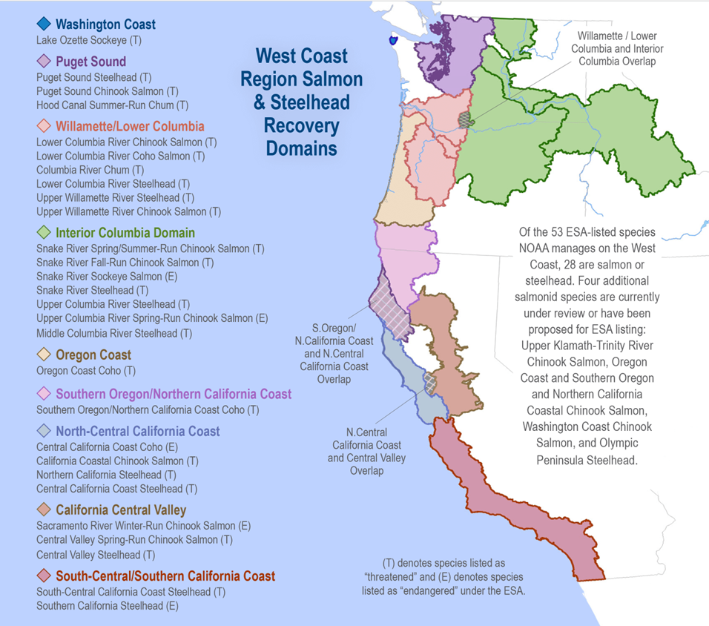
Photo credit: NOAA Fisheries

Slide 14
How are salmon doing?
Not great in the lower 48
28 population groups listed as endangered or threatened
13 in Columbia Basin
Notes:
Not great in the lower 48
28 population groups of salmon/trout listed as endangered or threatened under ESA
13 of these in Columbia Basin
Despite restoration efforts
$ 9 billion spent in Columbia Basin since 1990s

Slide 15
How are salmon doing?
Not great in the lower 48
28 population groups listed as endangered or threatened
13 in Columbia Basin
Despite restoration efforts
Notes:
Not great in the lower 48
28 population groups of salmon/trout listed as endangered or threatened under ESA
13 of these in Columbia Basin
Despite restoration efforts
$ 9 billion spent in Columbia Basin since 1990s

Slide 16
How are salmon doing?
Not great in the lower 48
28 population groups listed as endangered or threatened
13 in Columbia Basin
Despite restoration efforts
$ 9 billion spent in Columbia Basin since 1990s
Notes:
Not great in the lower 48
28 population groups of salmon/trout listed as endangered or threatened under ESA
13 of these in Columbia Basin
Despite restoration efforts
$ 9 billion spent in Columbia Basin since 1990s

Slide 17
How do we know how salmon are doing?

Slide 18
How do we know how salmon are doing?
We count them!

Slide 19
How do we know how salmon are doing?
We count them!
Well, we count some of them

Slide 20
How do we know how salmon are doing?
We count them!
Well, we count some of them and make educated guesses about the rest…

Slide 21
How do we know how salmon are doing?
We count them!
Well, we count some of them and make educated guesses about the rest…
Using a variety of methods

Slide 22
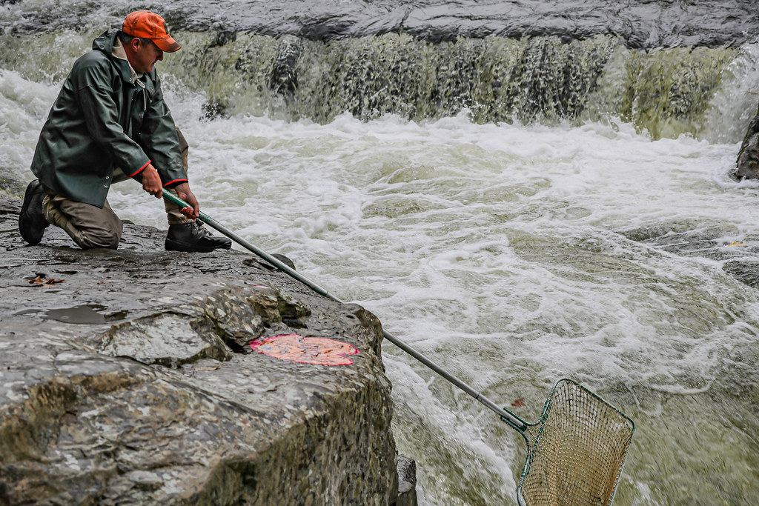
How do we know how salmon are doing?
Photo credit: US Bureau of Land Management
Notes:
Net survey

Slide 23
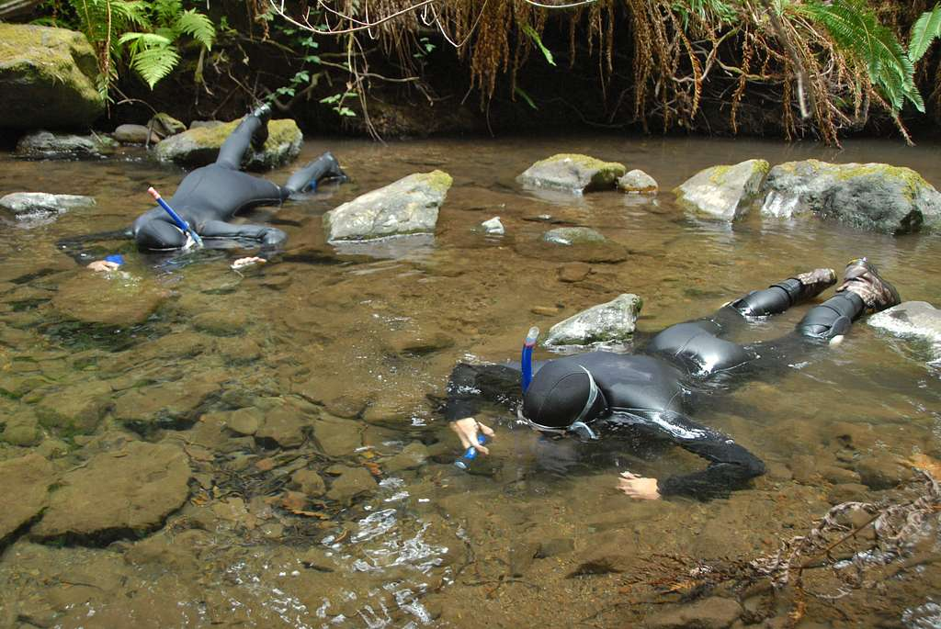
How do we know how salmon are doing?
Photo credit: National Parks Gallery
Notes:
Snorkel survey

Slide 24
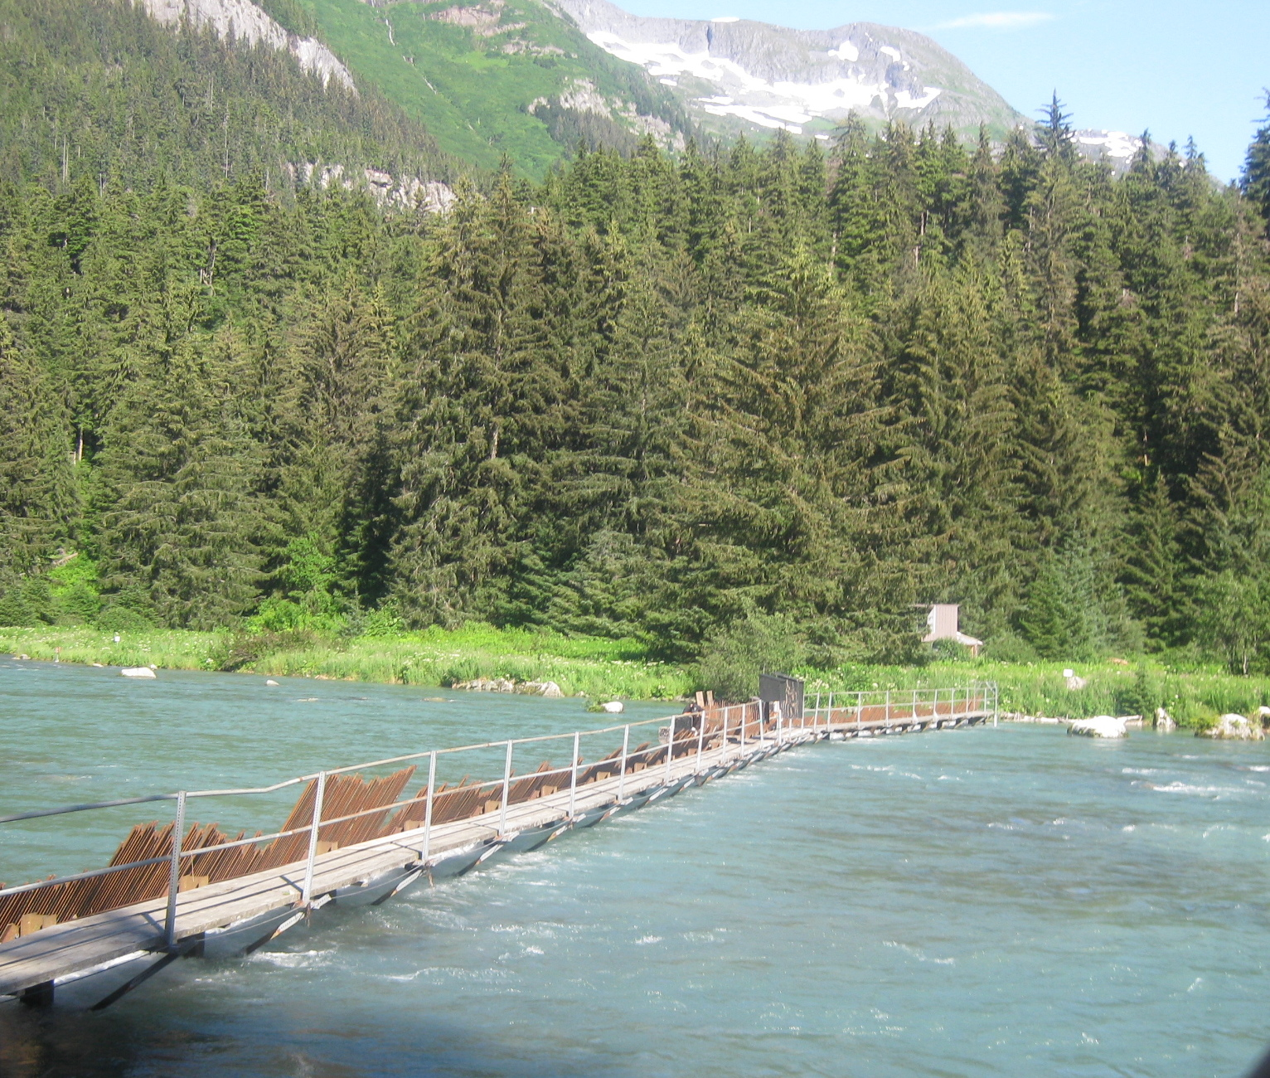
How do we know how salmon are doing?
Photo credit: Wikipedia Commons
Notes:
Weir

Slide 25
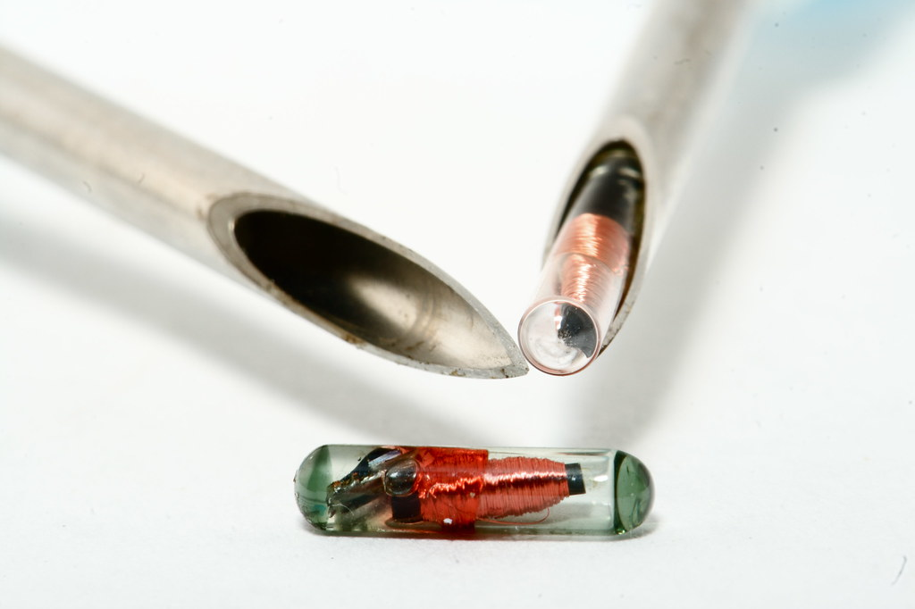
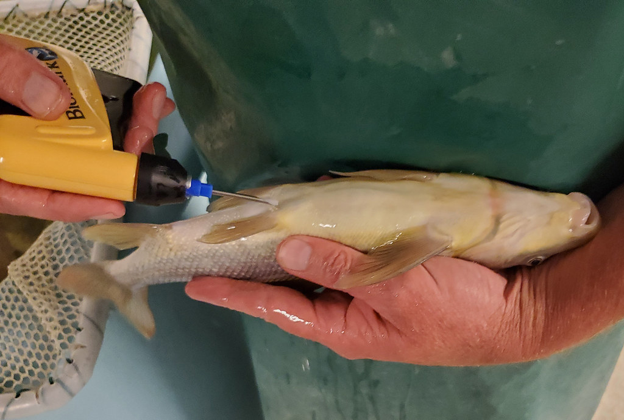
How do we know how salmon are doing?
Photo credit: US Fish and Wildlife Service
Notes:
PIT tag (passive integrated transponder)

Slide 26
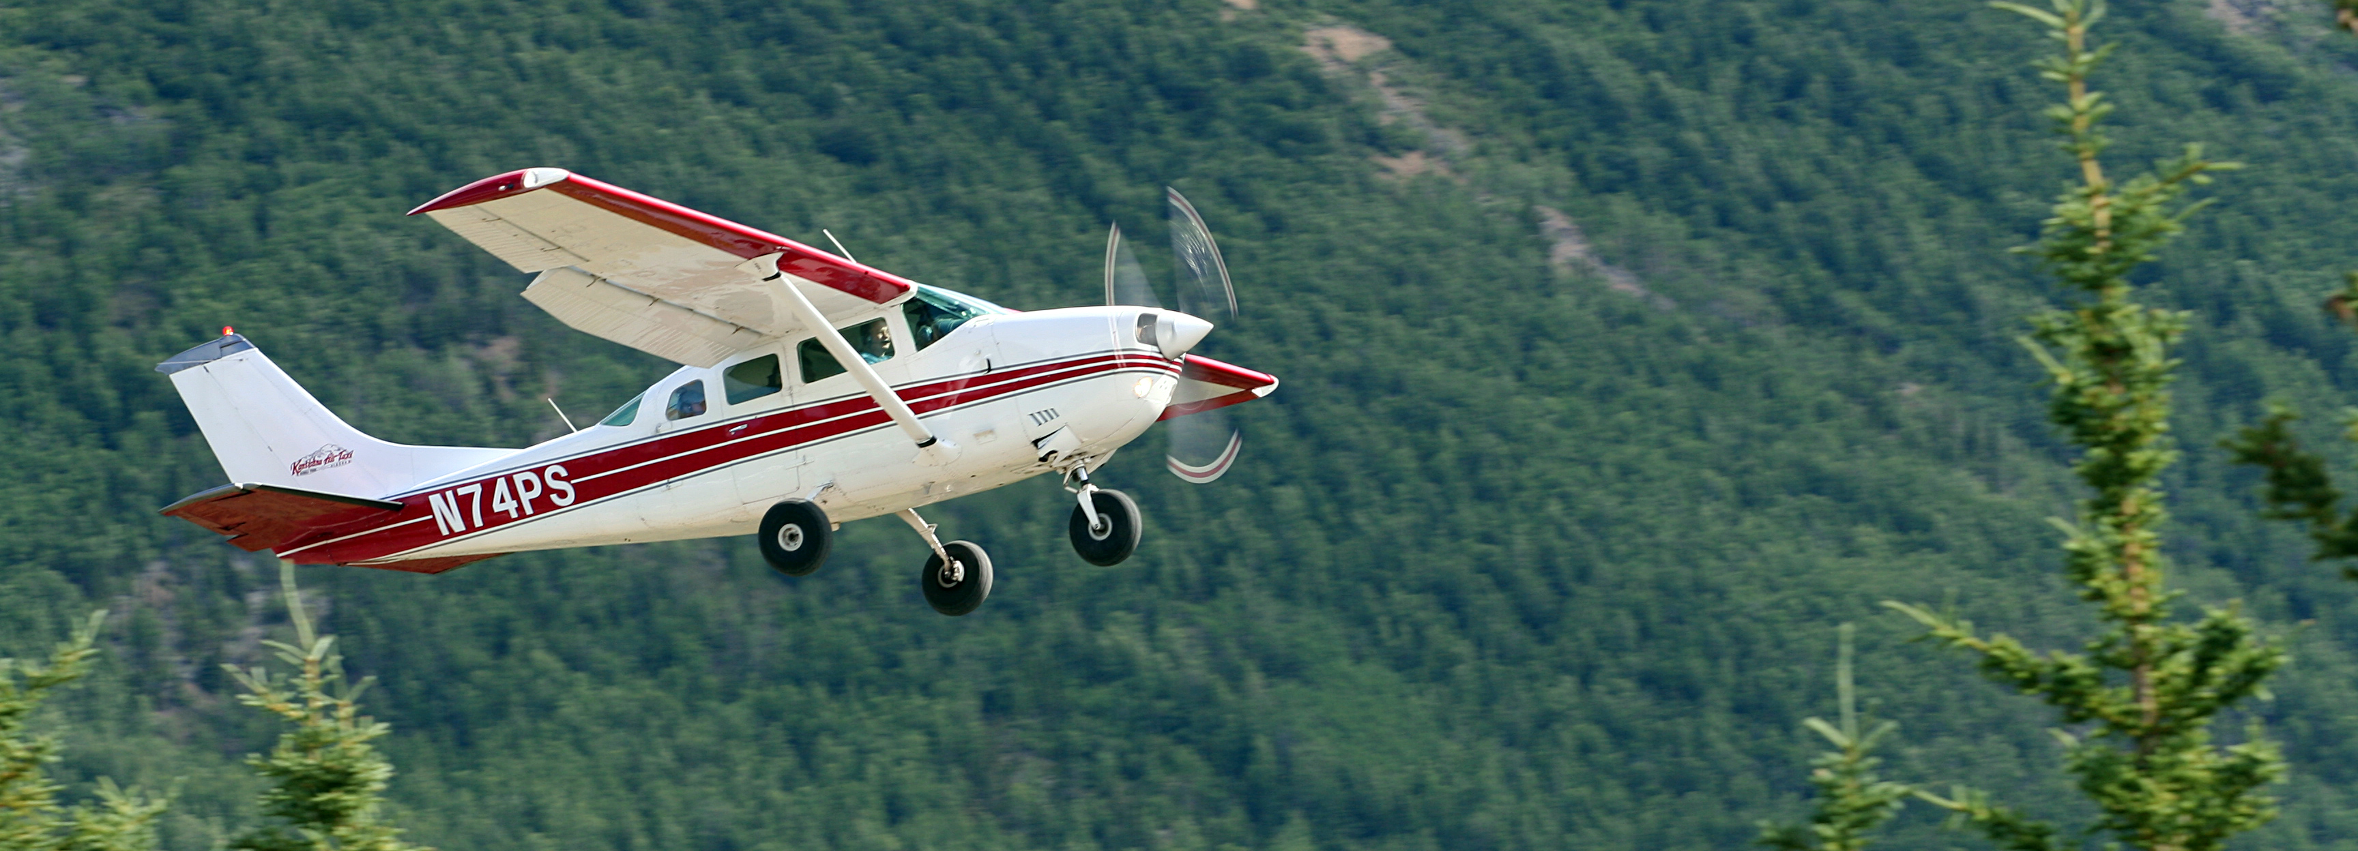
How do we know how salmon are doing?
Photo credit: Nic McPhee
Notes:
Aerial Survey (AK)

Slide 27
How do we know how salmon are doing?

Slide 28
Research goal: Evaluate salmon survey methods for precision and directional bias

Slide 29
Data

Slide 30
Data
Spawning salmon estimates in Oregon
68 salmonid populations
3 species: Chinook, coho, steelhead
Annual observations, 1980 to 2022
31 survey methods

Slide 31
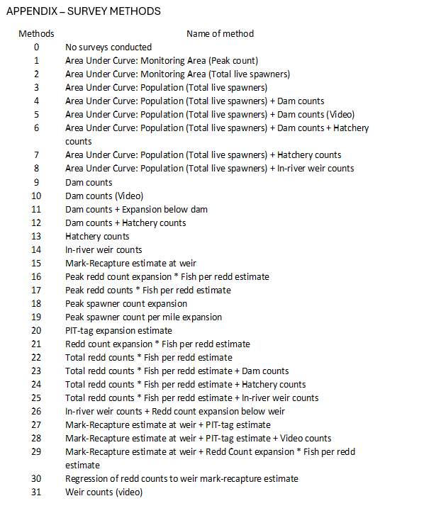
Data – survey methods

Slide 32
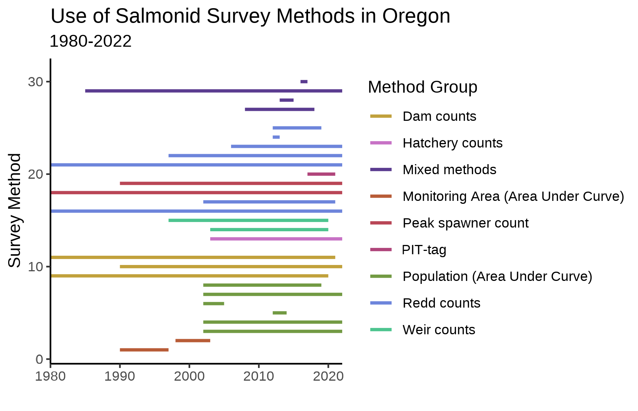
Data – survey methods

Slide 33
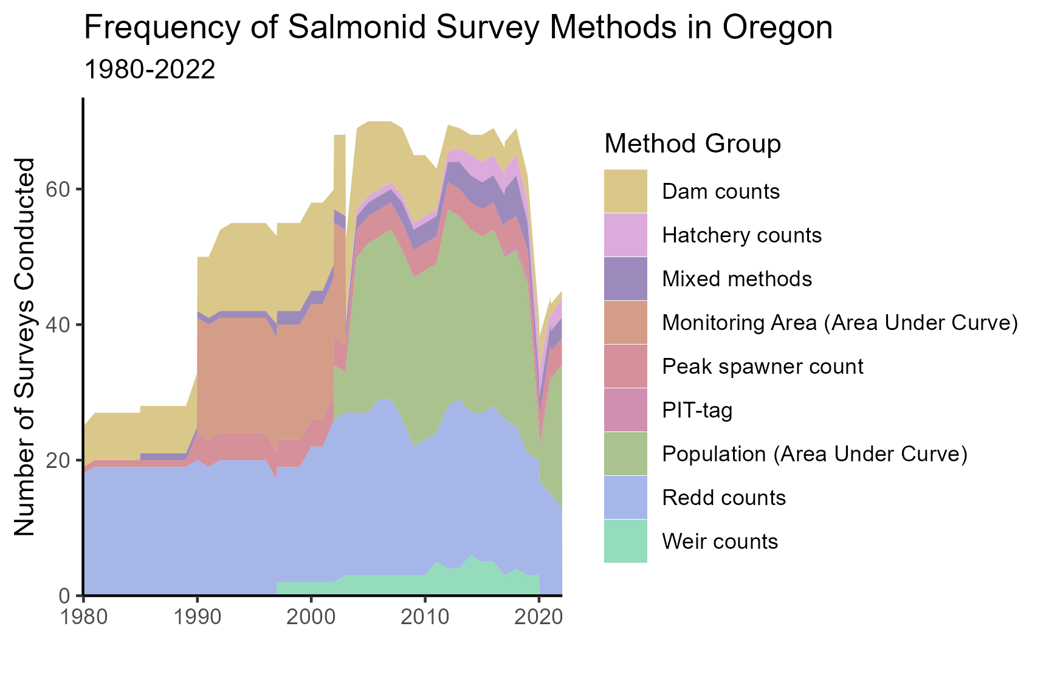
Data – survey methods

Slide 34
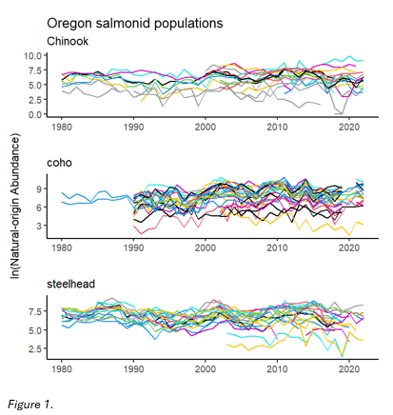
Data – abundance estimates

Slide 35
Analysis

Slide 36
Modeling approach
Multivariate Auto-Regressive State Space models
(MARSS)

Slide 37
Modeling approach
Multivariate Auto-Regressive State Space models
(MARSS)
Estimates underlying state based on observations

Slide 38
Modeling approach
Multivariate Auto-Regressive State Space models
(MARSS)
Estimates underlying state based on observations
Distinguishes observation error from noise in state being observed

Slide 39
Modeling approach
Multivariate Auto-Regressive State Space models
(MARSS)
x_{t} = Bx_{t−1} + u + w_{t}, where w_{t}∼MVN(0,Q)
y_{t} = Zx_{t} + a + v_{t}, where v_{t}∼MVN(0,R)

Slide 40
Modeling approach
MARSS models
Observation equation
x_{t} = Bx_{t−1} + u + w_{t}, where w_{t}∼MVN(0,Q)
y_{t} = Zx_{t} + a + v_{t}, where v_{t}∼MVN(0,R)

Slide 41
Modeling approach
MARSS models
Underlying state/process equation
x_{t} = Bx_{t−1} + u + w_{t}, where w_{t}∼MVN(0,Q)
y_{t} = Zx_{t} + a + v_{t}, where v_{t}∼MVN(0,R)

Slide 42
Modeling approach
Multivariate Auto-Regressive State Space models
Important features?
x_{t} = Bx_{t−1} + u + w_{t}, where w_{t}∼MVN(0,Q)
y_{t} = Zx_{t} + a + v_{t}, where v_{t}∼MVN(0,R)

Slide 43
Modeling approach
Multivariate Auto-Regressive State Space models
Important features
x_{t} = Bx_{t−1} + u + w_{t}, where w_{t}∼MVN(0,Q)
y_{t} = Zx_{t} + a + v_{t}, where v_{t}∼MVN(0,R)
Data

Slide 44
Modeling approach
Multivariate Auto-Regressive State Space models
Important features
x_{t} = Bx_{t−1} + u + w_{t}, where w_{t}∼MVN(0,Q)
y_{t} = Zx_{t} + a + v_{t}, where v_{t}∼MVN(0,R)
Data
Underlying state (estimates)

Slide 45
Modeling approach
Multivariate Auto-Regressive State Space models
Important features
x_{t} = Bx_{t−1} + u + w_{t}, where w_{t}∼MVN(0,Q)
y_{t} = Zx_{t} + a + v_{t}, where v_{t}∼MVN(0,R)
Data Trend (bias)
Underlying state (estimates)

Slide 46
Modeling approach
Multivariate Auto-Regressive State Space models
Important features
x_{t} = Bx_{t−1} + u + w_{t}, where w_{t}∼MVN(0,Q)
y_{t} = Zx_{t} + a + v_{t}, where v_{t}∼MVN(0,R)
Data Trend (bias)
Underlying state (estimates) Error terms

Slide 47
Modeling approach
What am I concerned with?
x_{t} = Bx_{t−1} + u + w_{t}, where w_{t}∼MVN(0,Q)
y_{t} = Zx_{t} + a + v_{t}, where v_{t}∼MVN(0,R)
Data Trend (bias)
Underlying state (estimates) Error terms

Slide 48
Modeling approach
What am I concerned with?
x_{t} = Bx_{t−1} + u + w_{t}, where w_{t}∼MVN(0,Q)
y_{t} = Zx_{t} + a + v_{t}, where v_{t}∼MVN(0,R)
I am interested in observation bias (a) and observation variance (R)

Slide 49
Results

Slide 50
Results
Precision (R) and bias (a) terms estimated for 19 survey methods

Slide 51
Results
Precision (R) and bias (a) terms estimated for 19 survey methods
12 methods with very few data points in the time series

Slide 52
Results
Precision (R) and bias (a) terms estimated for 19 survey methods
12 methods with very few data points in the time series
Not every method evaluated for every species

Slide 53
Results
Precision (R) and bias (a) terms estimated for 19 survey methods
12 methods with very few data points in the time series
Not every method evaluated for every species
Bias can only be estimated relative to pre-specified reference method

Slide 54
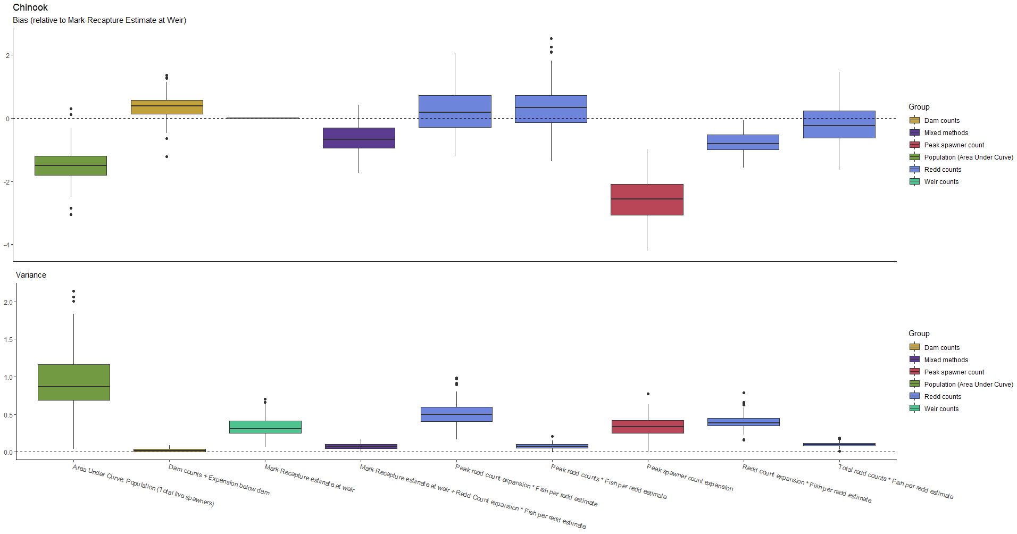
Results - Chinook

Slide 55
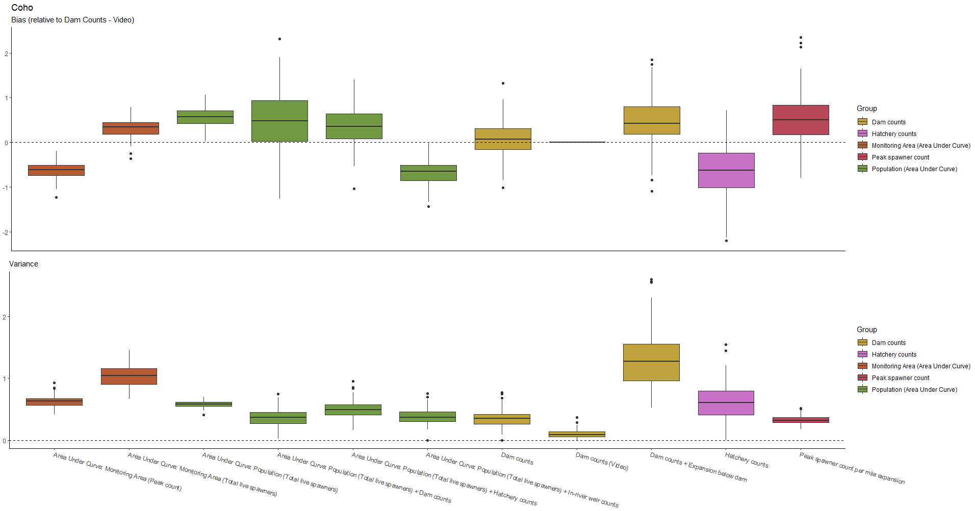
Results - Chinook

Slide 56
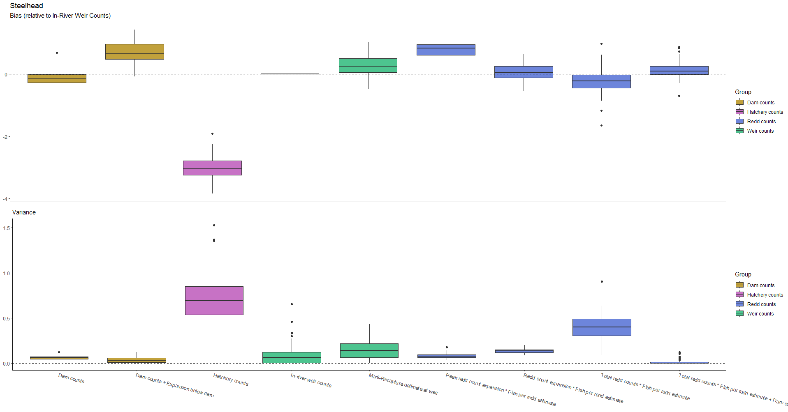
Results - Chinook

Slide 57
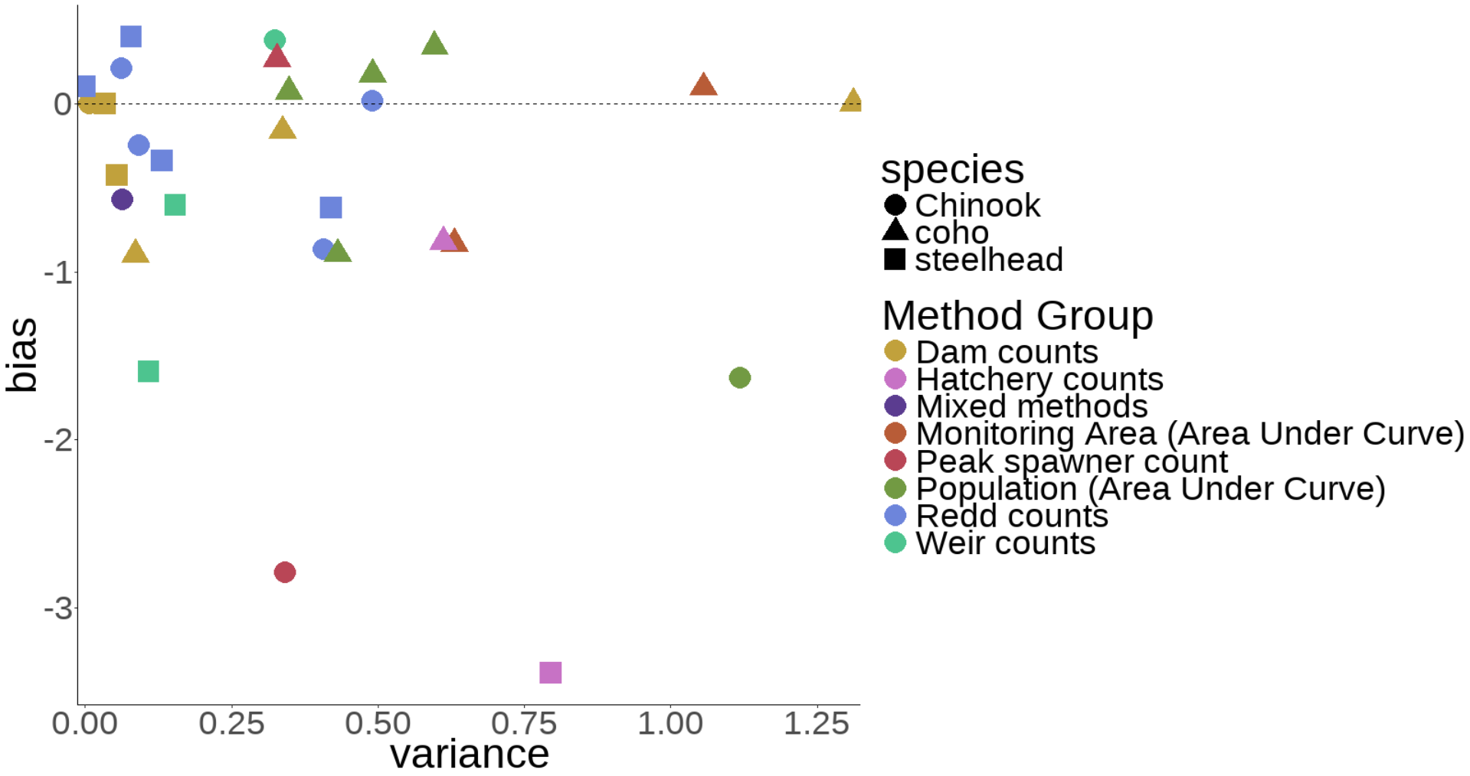
Results – all species
Reference method: Dam counts + Expansion below dam, a=0

Slide 58
Results
The same survey method can have very different levels of precision between species
Notes:
Area-under-curve methods perform reasonably well for coho and poorly for Chinook

Slide 59
Results
The same survey method can have very different levels of precision between species
Bias also seen to trend in different directions across species

Slide 60
Results
Coho generally more difficult to count precisely than Chinook or steelhead

Slide 61
Results
Coho generally more difficult to count precisely than Chinook or steelhead
Dam counts, weir counts, and redd counts tend to be most precise

Slide 62
Results
Coho generally more difficult to count precisely than Chinook or steelhead
Dam counts, weir counts, and redd counts tend to be most precise
Hatchery counts are not great

Slide 63
Discussion & Next Steps

Slide 64
Discussion
Wide variety of survey methods available to biologists

Slide 65
Discussion
Wide variety of survey methods available to biologists
Understanding bias and precision is crucial

Slide 66
Discussion
Wide variety of survey methods available to biologists
Understanding bias and precision is crucial
Decisions such as ESA listing and restoration funding are dependent on accurate estimates

Slide 67
Next Steps
Evaluate cost of survey methods
Notes:
Value of information

Slide 68
Next Steps
Evaluate cost of survey methods
Consider tradeoffs between cost and accuracy
Notes:
More accurate counts valuable for most vulnerable populations?

Slide 69
Next Steps
Evaluate cost of survey methods
Consider tradeoffs between cost and accuracy
Optimizing utility of limited budgets
Notes:
Making the most of money available is more crucial than ever

Slide 70





Understanding precision and directional bias of fisheries abundance estimates across 31 commonly used salmonid survey methods
Brian McGreal bmcgreal@uw.edu

Slide 71
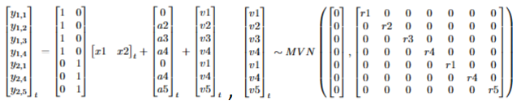
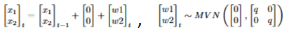
Modeling approach
Specifying matrices properly is crucial

Slide 72
Modeling approach
Specifying matrices properly is crucial
A reference method must be chosen to estimate bias

Slide 73
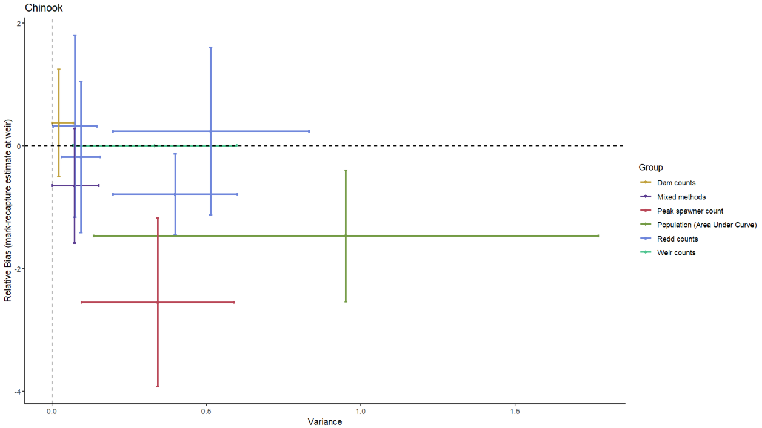
Results - Chinook

Slide 74
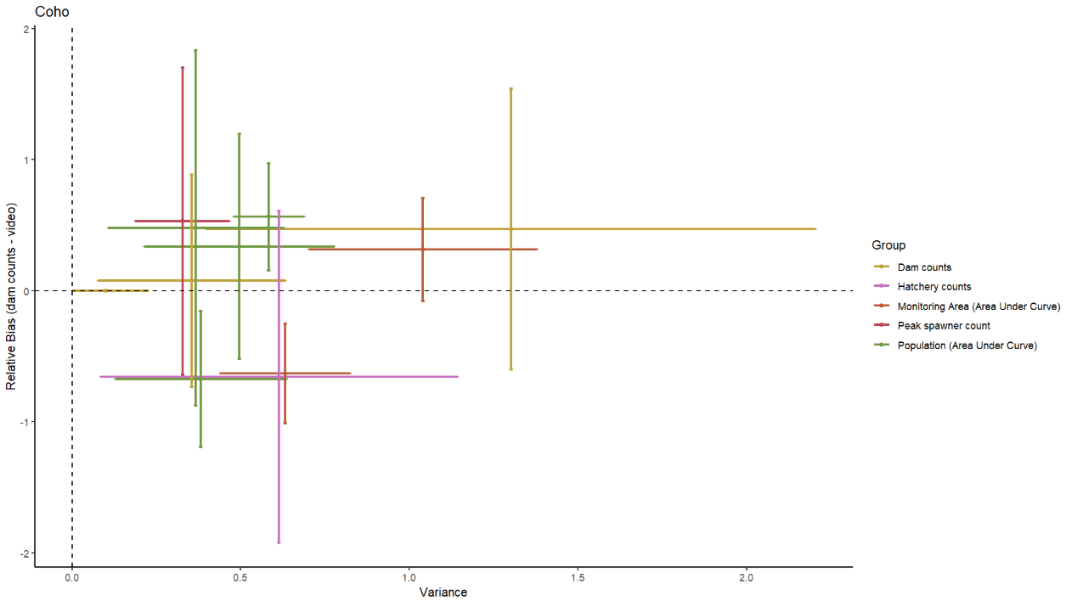
Results - coho

Slide 75
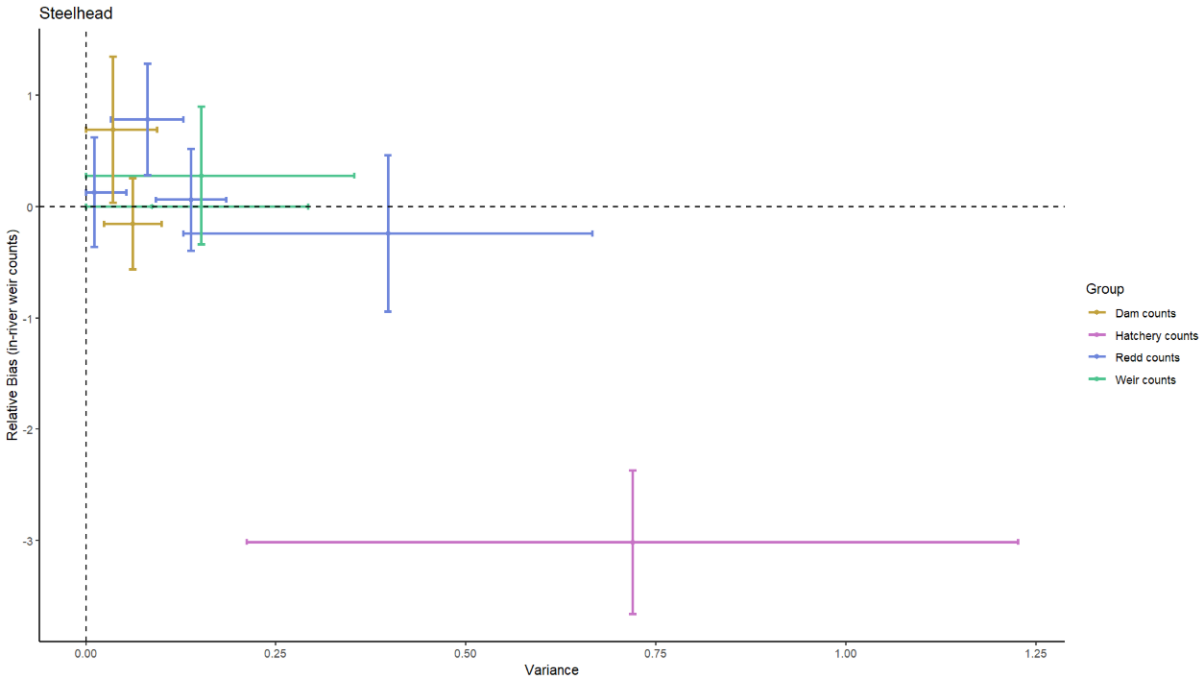
Results - steelhead

Slide 76
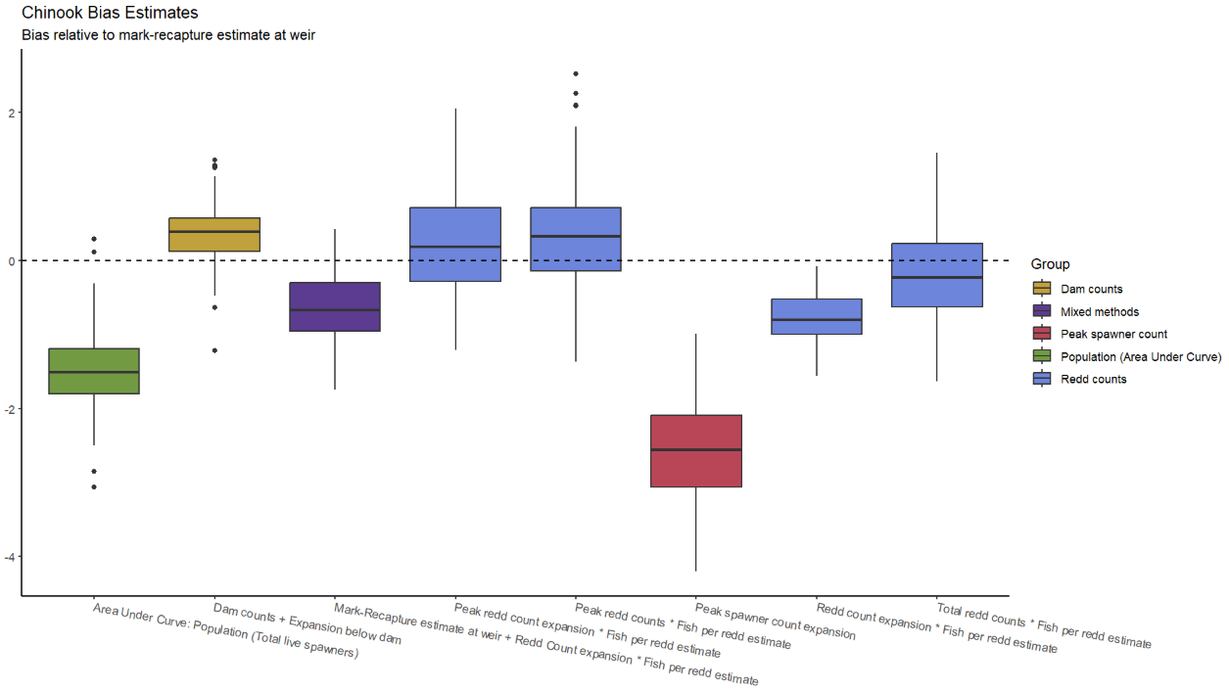
Results - Chinook

Slide 77
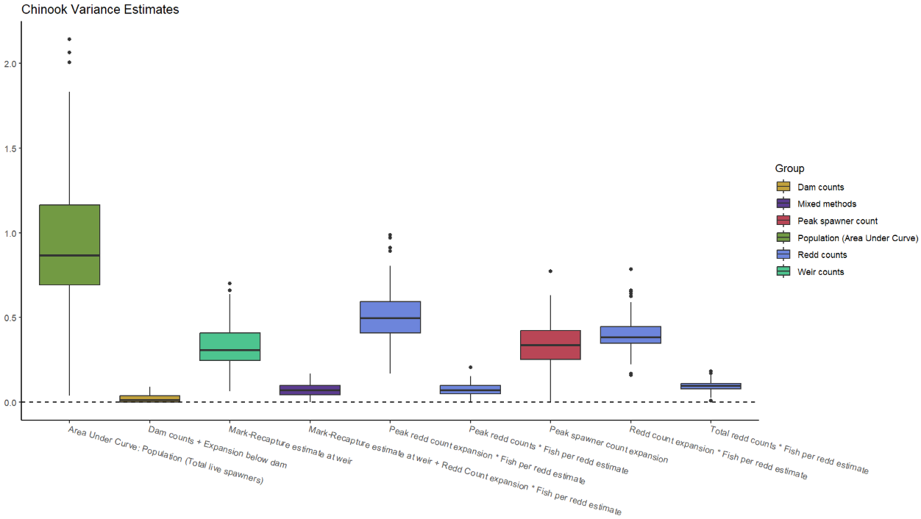
Results - Chinook

Slide 78
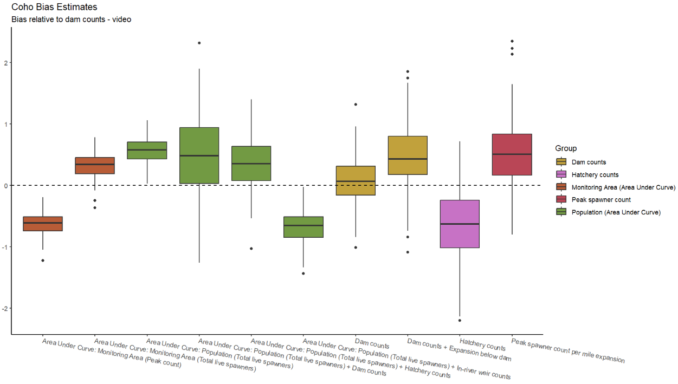
Results - coho

Slide 79
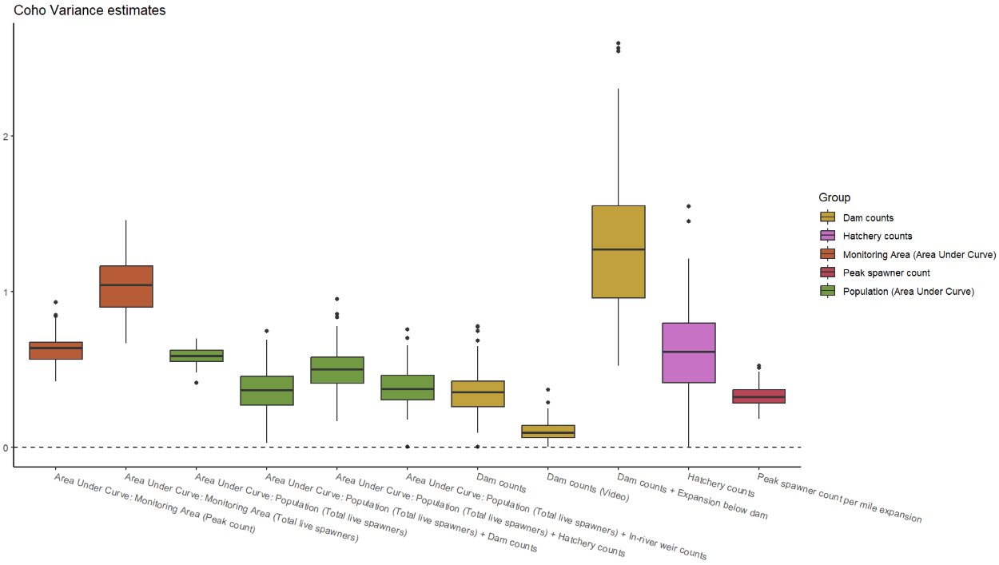
Results - coho

Slide 80
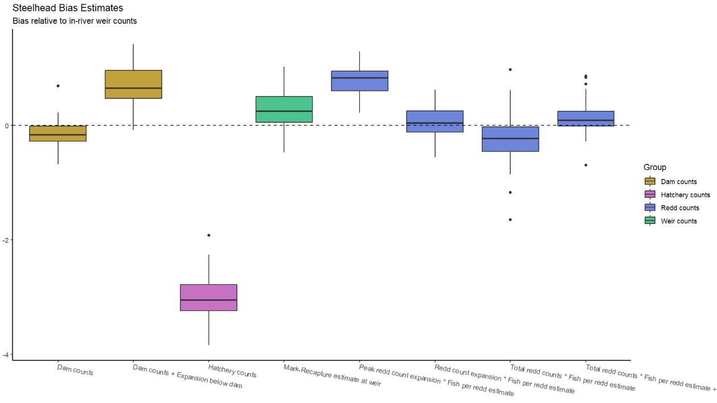
Results - steelhead

Slide 81
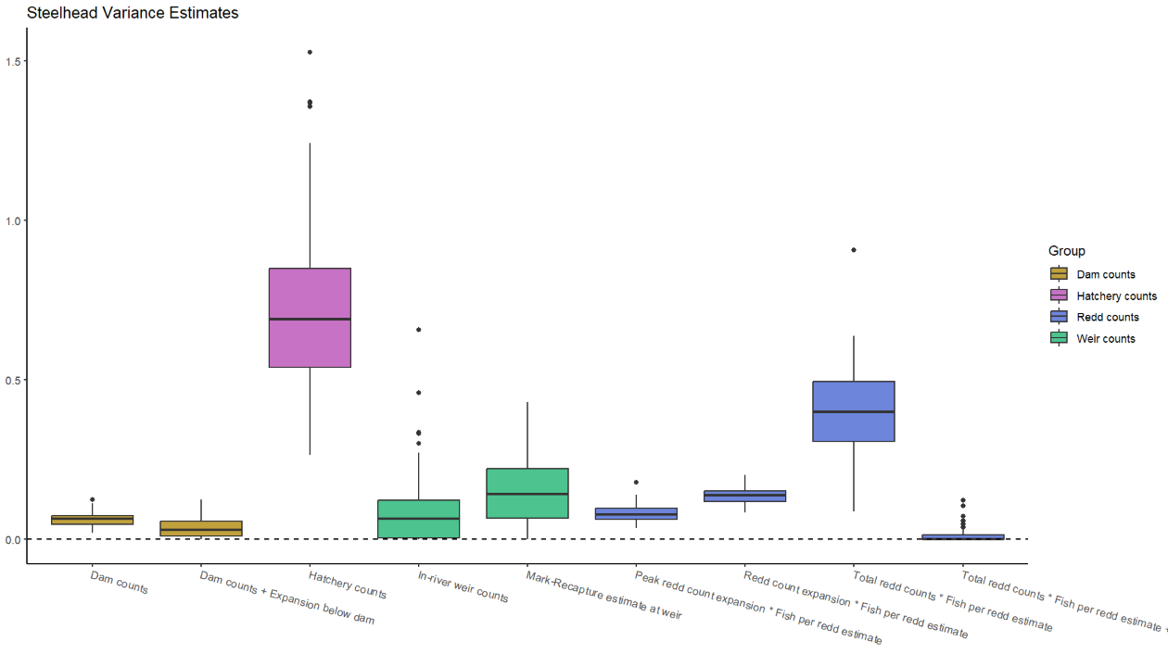
Results - steelhead

